Slide 1
OOP Using Java
By: Ghulam Mujtaba Shaikh

Slide 2
Java AWT and Swings working with GUI

Slide 3
Topics for Discussion
GUI
AWT Controls
Swing Controls
AWT versus Swings
Steps for making GUI Application
Example of GUI Application
Layout Managers
Flow Layout
Grid Layout
Border Layout
Building the complex GUI Application

Slide 4
Suggested Reading
Chapter No. 21
  Introducing the AWT: Working with windows, Graphics and Text
Chapter No. 22
  Using AWT Controls, Layout Managers and Menus
Book
  Java2 Complete Reference Fourth Edition by HERBERT SCHILDT

Slide 5
Support for GUI
AWT
Swings
Java.awt and javax.swing
awt (old) vs swings (new)
Controls like VB6.0
Java API documentation will be your best friend

Slide 6
AWT V/S Swings
Button, JButton
AWT depend upon operating system
Heavy weight components
Swings purely write in java
Swings are light weight processes
Do not depend upon operating system
Portable

Slide 7
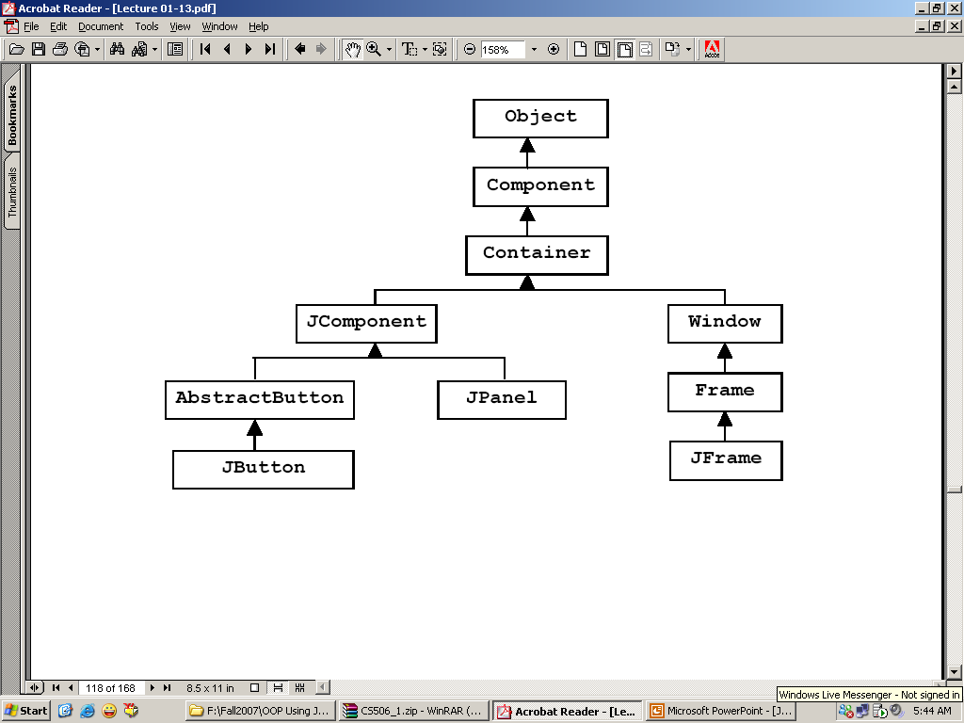
Apart from the Framework

Slide 8
Components
Simple Components
Container Components

Slide 9
GUI Creation Steps
Step No. 1
Import the required package
import java.awt.* ;
import javax.swing.* ;

Slide 10
GUI Creation Steps
Step No. 2
Setup the top level components
JFrame myFrame = new JFrame () ;
Note: JFrame is a container component.

Slide 11
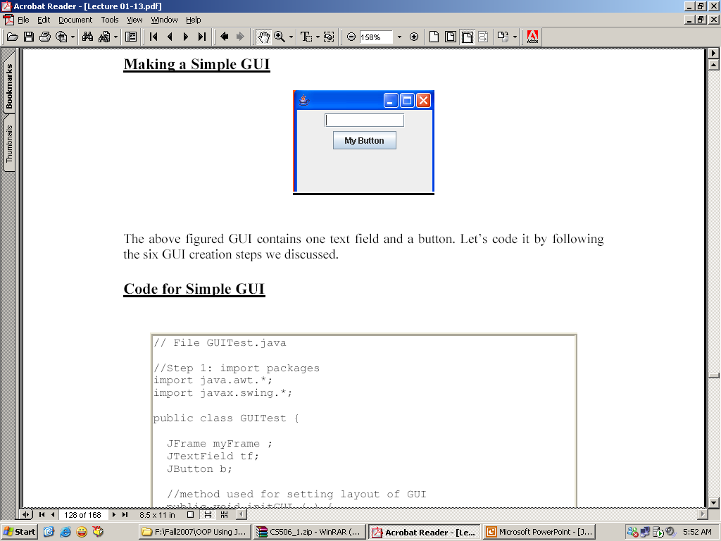
GUI Creation Steps
Step No. 3
Get the component area of the top level component.
Container c = myFrame.getContentPane () ;
System Area
Components Area

Slide 12
GUI Creation Steps
Step No. 4
Apply layout to that areas
c.setLayout (new FlowLayout ()) ;

Slide 13
GUI Creation Steps
Step No. 5
Create and add components
JButton b1 = new JButton (“Click Me!”) ;
c.add (b1) ;

Slide 14
GUI Creation Steps
Step No. 6
Set size of the frame and make it visible.
myFrame.setSize (200 , 200) ;
myFrame.setVisible (true) ;

Slide 15
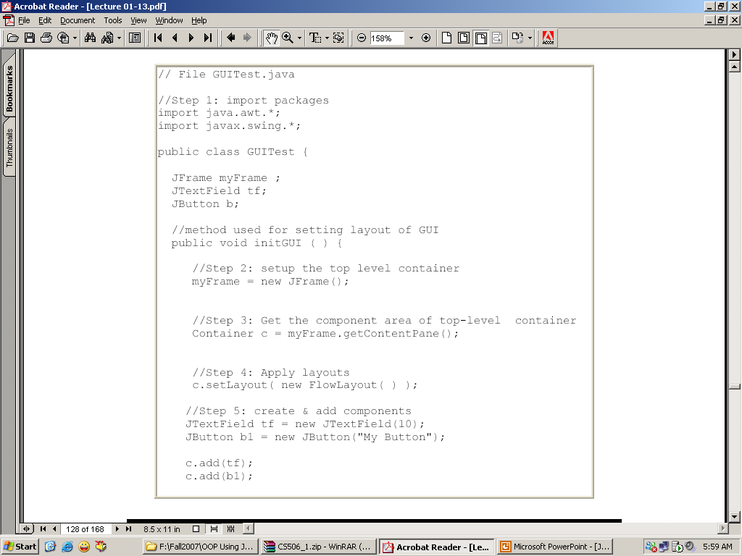
Example No. 1

Slide 16
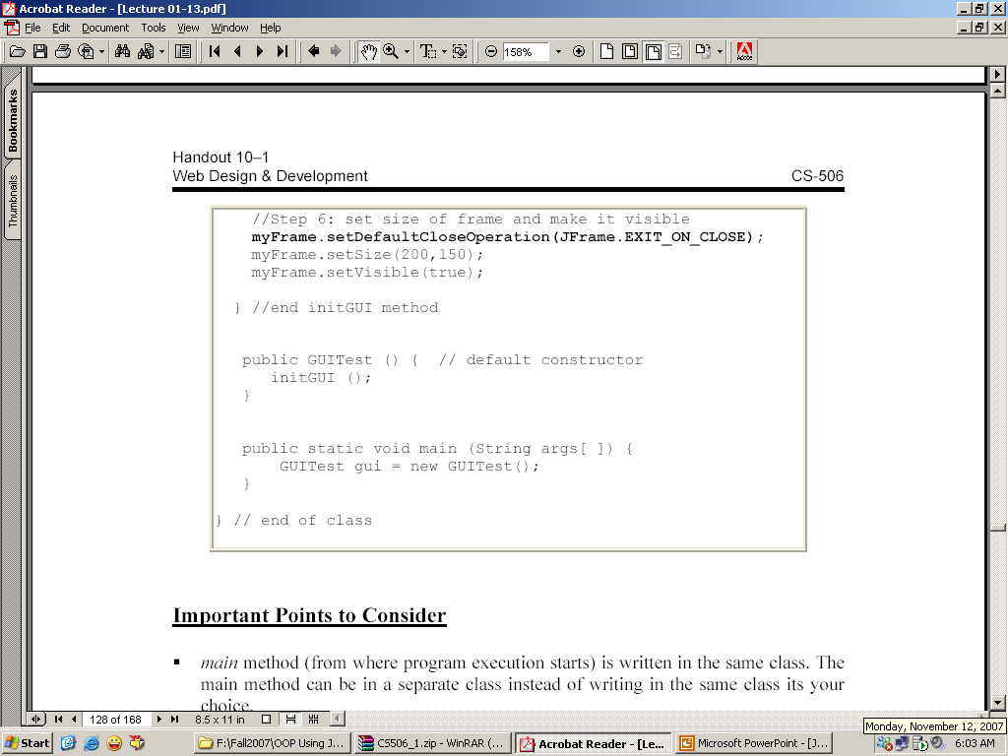

Slide 17
Layout Managers
Many supplied by Java
For Example:
  FlowLayout
  GridLayout
  BorderLayout
  BoxLayout
  GridBagLayout
We use first three layouts.

Slide 18
Flow Layout
Position components on line by line basis.
Each time line is filled a new line will be started.
The size of line depends upon the frame, which we created.
If we scratch the frame the GUI will be disturbed.

Slide 19
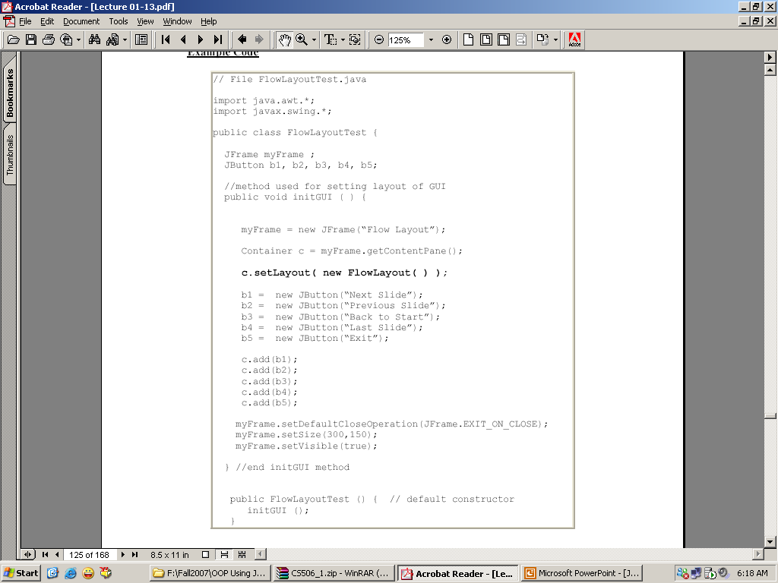
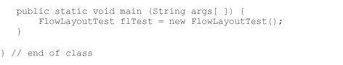
Example

Slide 20
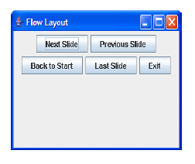
Output of previous Example

Slide 21
Grid Layout
Split the panel into cells or grids with given number of rows and columns
One component occupy the whole cell
Size of each component is same
Components are added row wise

Slide 22
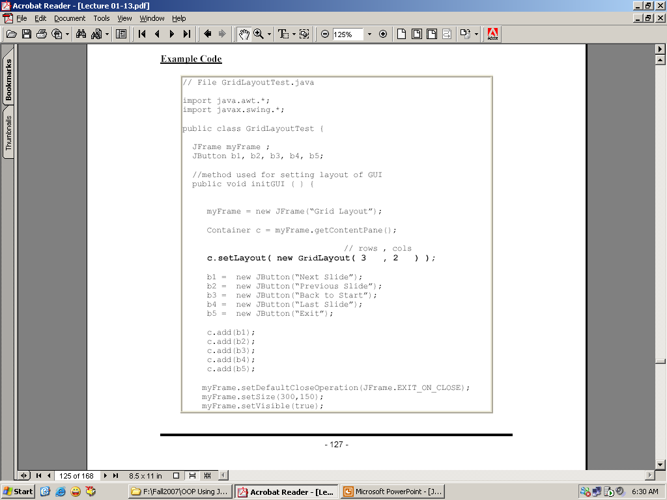
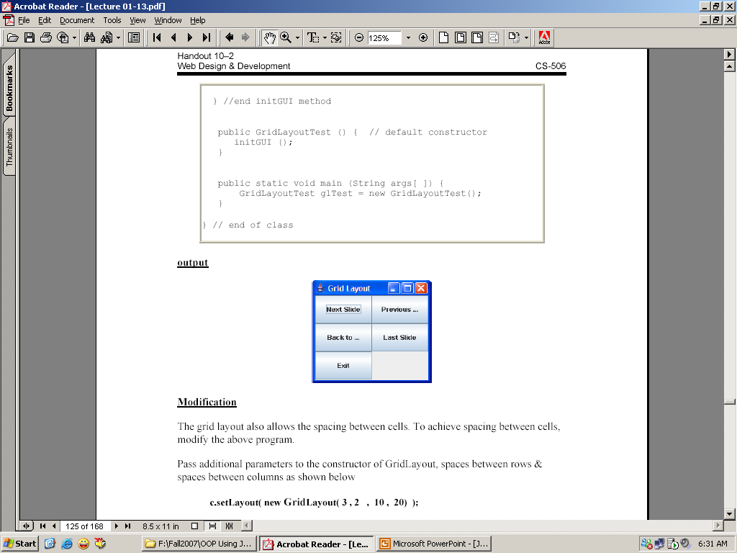
Example

Slide 23
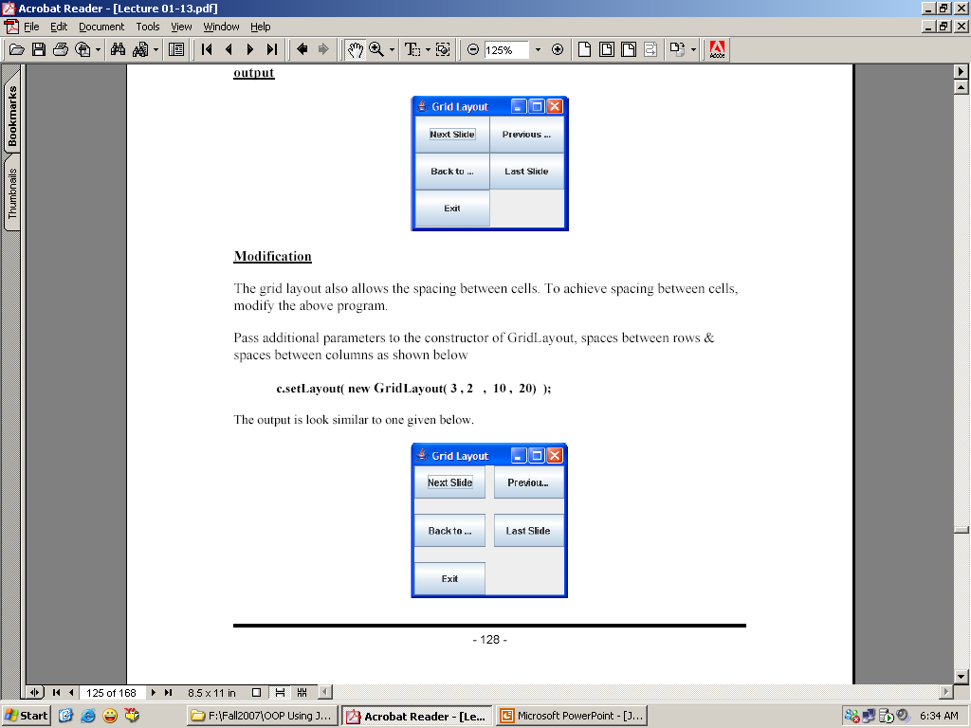
Output of previous Example

Slide 24
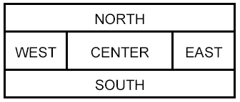
Border Layout
Divides the area into five regions.
North, South, East, West and Center
Components are added to the specified region.
Only one component at one region

Slide 25
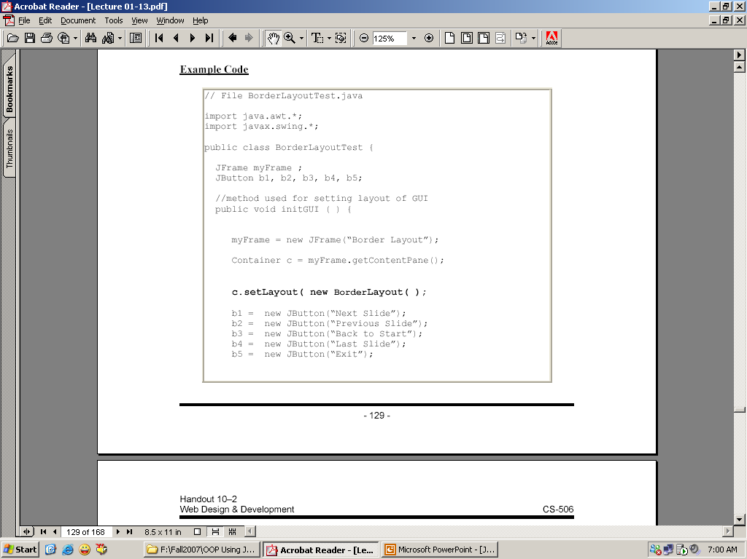

Slide 26
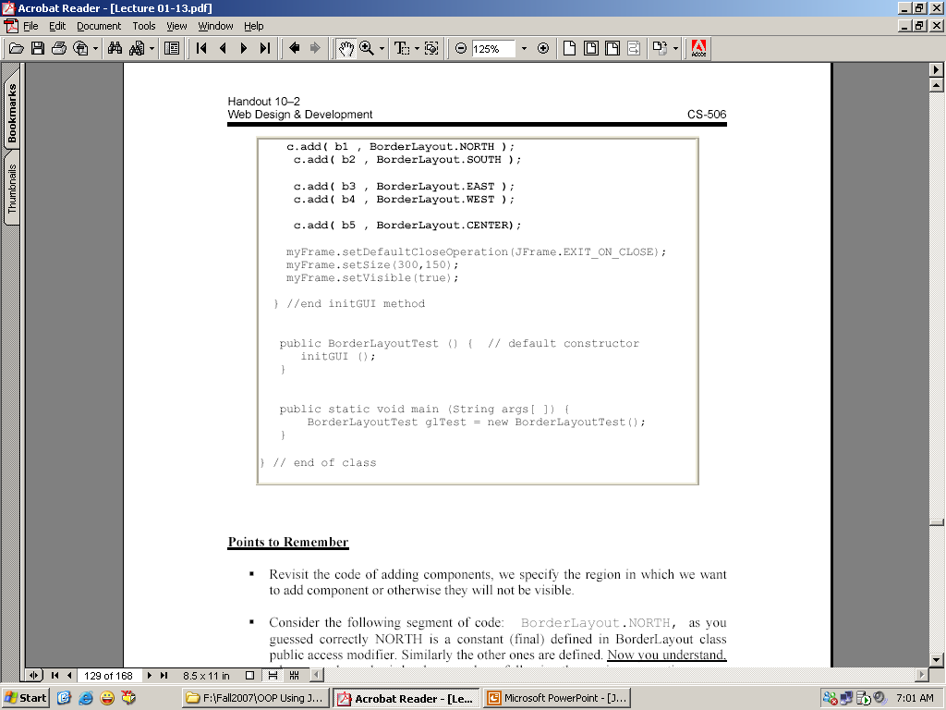

Slide 27
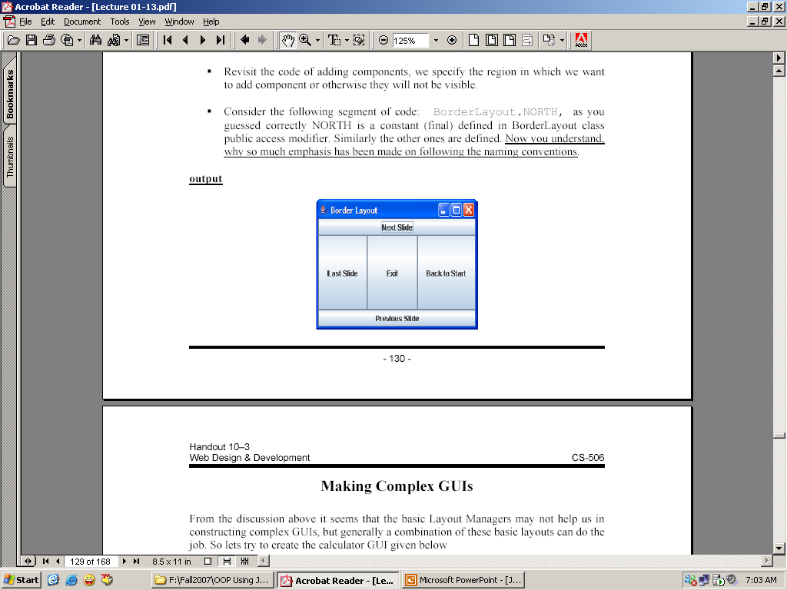
Output of previous Example

Slide 28
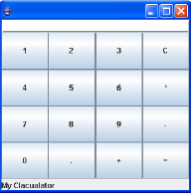
Making the complex GUIs

Slide 29
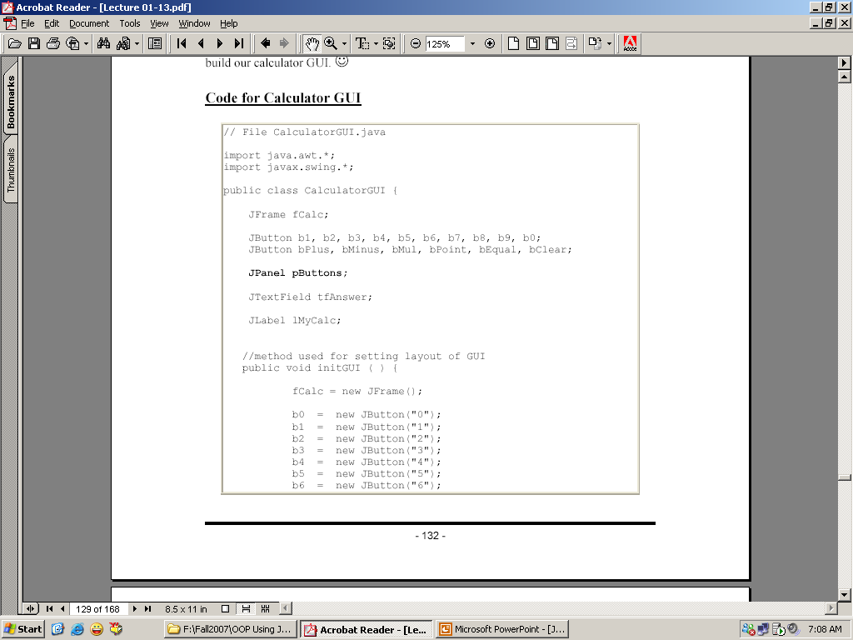
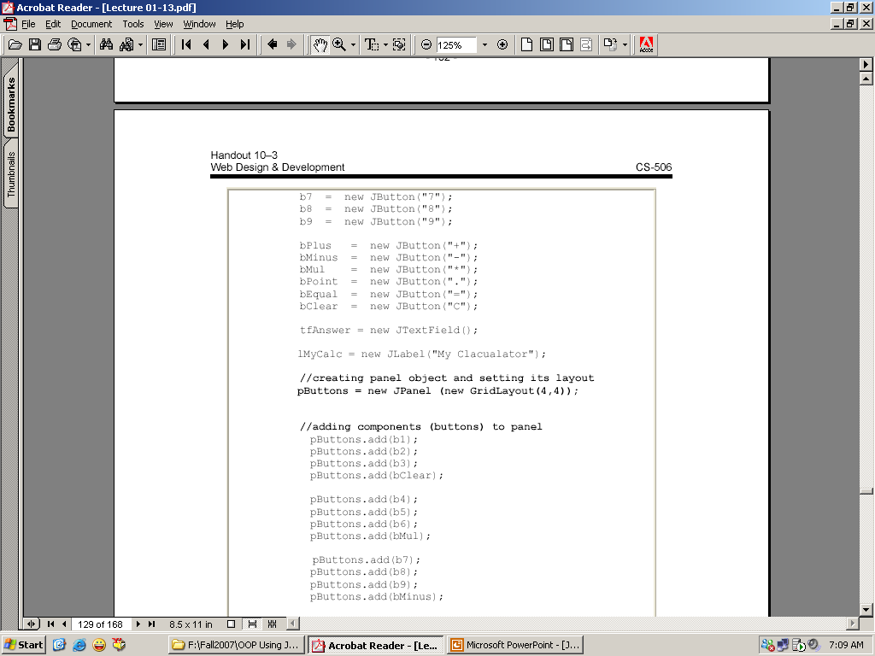

Slide 30
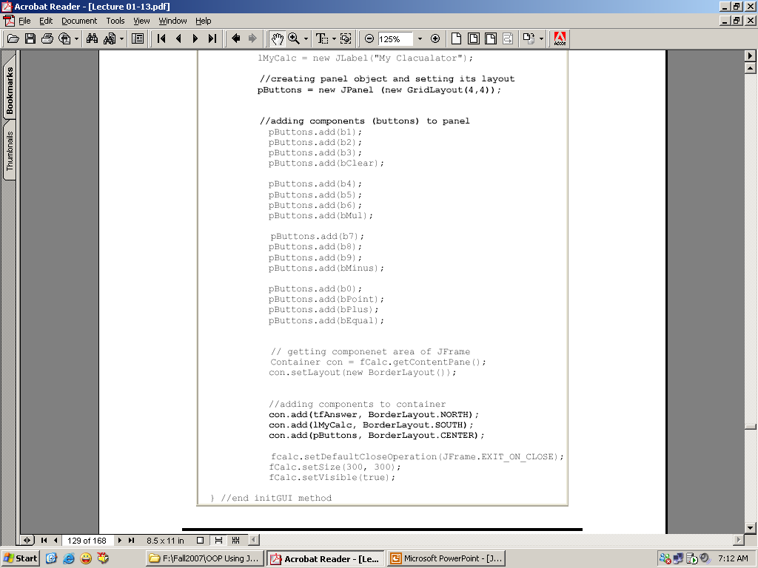

Slide 31
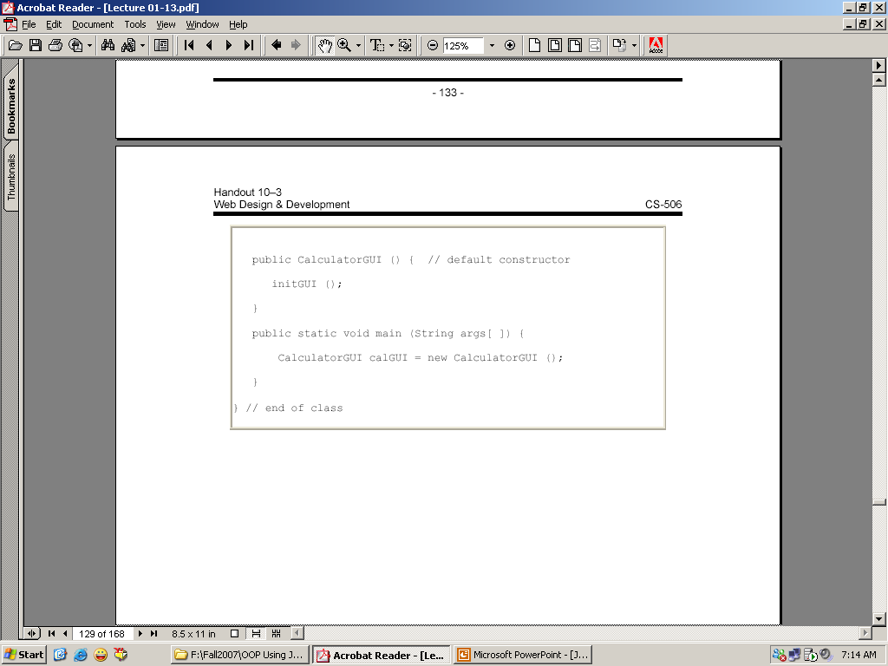

Slide 32
Recap of the Today’s Discussion
GUI
AWT Controls
Swing Controls
AWT versus Swings
Steps for making GUI Application
Example of GUI Application
Layout Managers
Flow Layout
Grid Layout
Border Layout
Building the complex GUI Application

Slide 33
Coming up Topics
Event Handling

